Slide 1
NETFLIX MOVIES AND TV SHOWS CLUSTERING
Individual Project
Rishika Rai

Slide 2
Content
1 | Steps in UnSupervised ML | 3
2 | Problem Statement | 4
3 | Data Summary | 5
4 | Missing Value Treatment | 7
5 | Exploratory Data Analysis | 8
6 | Correlation Analysis | 21
7 | Feature Engineering | 22
8 | Apply Clustering Model | 23
9 | Conclusion | 25

Slide 3
Steps In Unsupervised ML
Define
Problem statement
EDA & Data splitting for test and training
Model Comparison and Evaluation
Step 1
Step 3
Step 5
Output
Step 2
Step 4
Step 6
Preprocessing Data
Data Validation
Train different models
Check Model Score
Improve Model
Hyperparameter Tuning

Slide 4

Problem statement
This dataset contains TV shows and movies that are currently available on Netflix as of 2019. The data was gathered from Flixable, a third-party Netflix search engine. Integrating this dataset with other external datasets such as IMDB ratings and rotten tomatoes can yield a plethora of interesting results.

Slide 5
Data Summary:
This dataset consists of tv shows and movies available on Netflix as of 2019. The dataset is
collected from Flixable which is a third-party Netflix search engine.
In 2018, they released an interesting report which shows that the number of TV shows on Netflix has nearly tripled since 2010. The streaming services number of movies has decreased by more than 2,000 titles since 2010, while its number of TV shows has nearly tripled. It will be interesting to explore what all other insights can be obtained from the same dataset.
Integrating this dataset with other external datasets such as IMDB ratings, rotten tomatoes can also provide many interesting findings.
The dataset consists of listings of all the movies and tv shows available on Netflix, along with details
such as - cast, directors, ratings, release year, duration, etc

Slide 6
Contd..
● show_id : Unique ID for every Movie / Tv Show
● type : Identifier - A Movie or TV Show
● title : Title of the Movie / Tv Show
● director : Director of the Movie
● cast : Actors involved in the movie / show
● country : Country where the movie / show was produced
● date_added : Date it was added on Netflix
● release_year : Actual Release Year of the movie / show
● rating : TV Rating of the movie / show
● duration : Total Duration - in minutes or number of seasons
● listed_in : Genre
● description: The Summary description

Slide 7
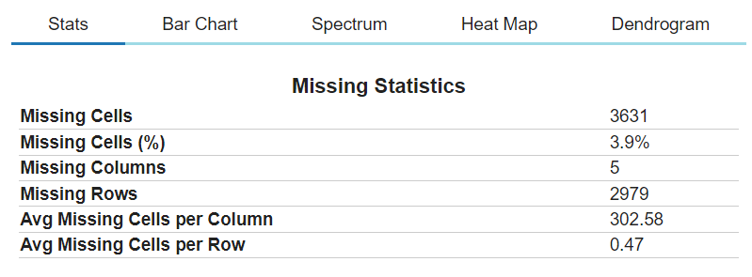
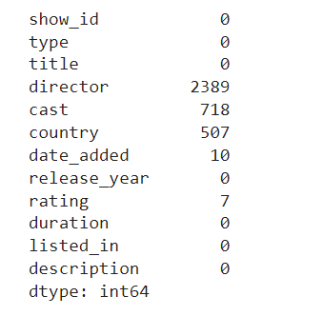
Missing Value Treatment :
There are 3631 null values in the dataset.
2389 null values in director column
718 null values in cast column
507 null values in country column
10 in date_added and 7 in rating
we cannot drop all the missing records we have filled them with strings and irrelevant feature we have dropped out.

Slide 8
Exploratory Data Analysis
The EDA for this dataset is done with the help of DataPrep Library.
The goal of create_report is to generate profile reports from a pandas DataFrame. create_report utilises the functionalities and formats the plots from dataprep. It provides the following information:
Overview: detect the types of columns in a dataframe
Variables: variable type, unique values, distinct count, missing values
Quantile statistics like minimum value, Q1, median, Q3, maximum, range, interquartile range
Descriptive statistics like mean, mode, standard deviation, sum, median absolute deviation, coefficient of variation, kurtosis, skewness
Text analysis for length, sample and letter
Correlations: highlighting of highly correlated variables, Spearman, Pearson and Kendall matrices
Missing Values: bar chart, heatmap and spectrum of missing values
In the following, we break down the report into different sections to demonstrate each part of the report.

Slide 9
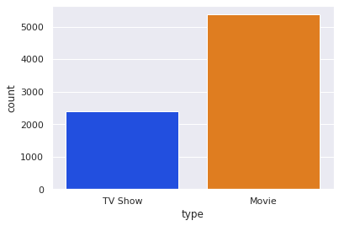
Type
Netflix has 5372 movies and 2398 TV shows.
There are more number of movies are present on Netflix than the TV shows.
Feature Analysis -

Slide 10
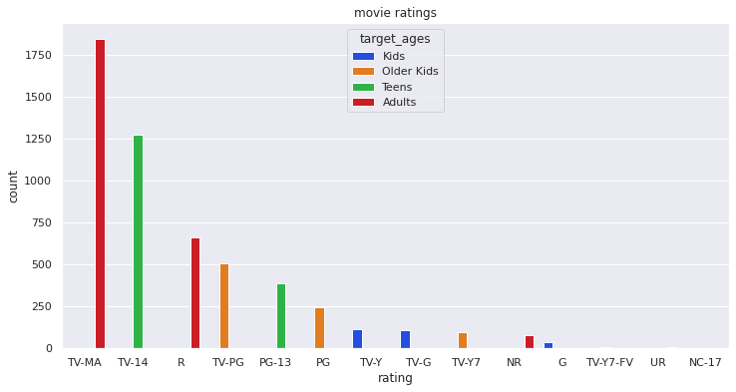
Ratings
TV-MA type of content is preferred by adults and it has highest ratings.
TV-14 typr of content is preferred by teens and it has second highest ratings.
R type of content is preferred by adults.
TV-PG is preferred by older kids.

Slide 11
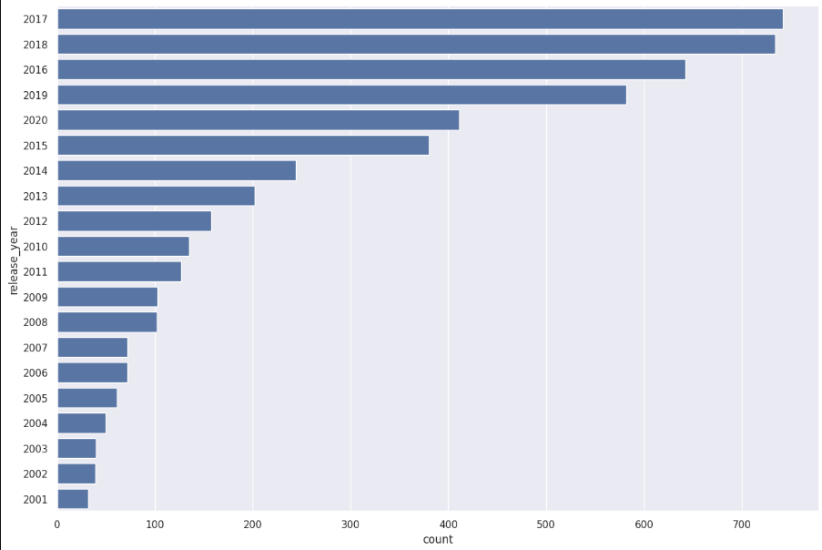
Release_Year

Slide 12
Release_year contiuned
Highest number of movies released in 2020 along with 2017 and 2018
The number of movies on Netflix is growing significantly faster than the number of TV shows.
We saw a huge increase in the number of movies and television episodes after 2015.
There is a significant drop in the number of movies and television episodes produced after 2020.
It appears that Netflix has focused more attention on increasing Movie content that TV Shows. Movies have increased much more dramatically than TV shows.

Slide 13
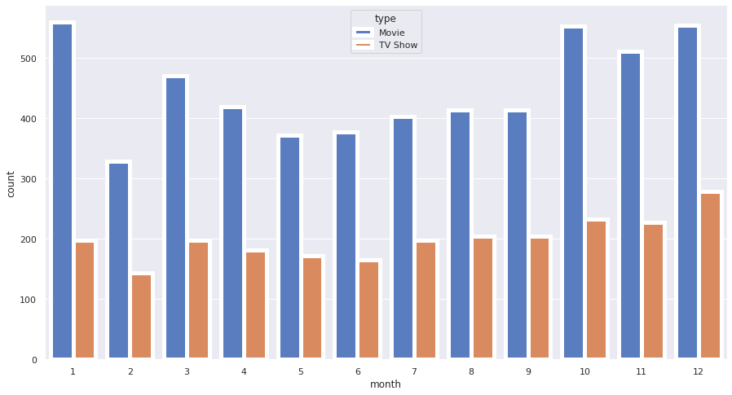
Release_month
This plot shows from march to september netflix added around 200 TV shows every month and they increased this number from october till january.
Year end and start of the year is showing a significant addition of the content in netflix.

Slide 14
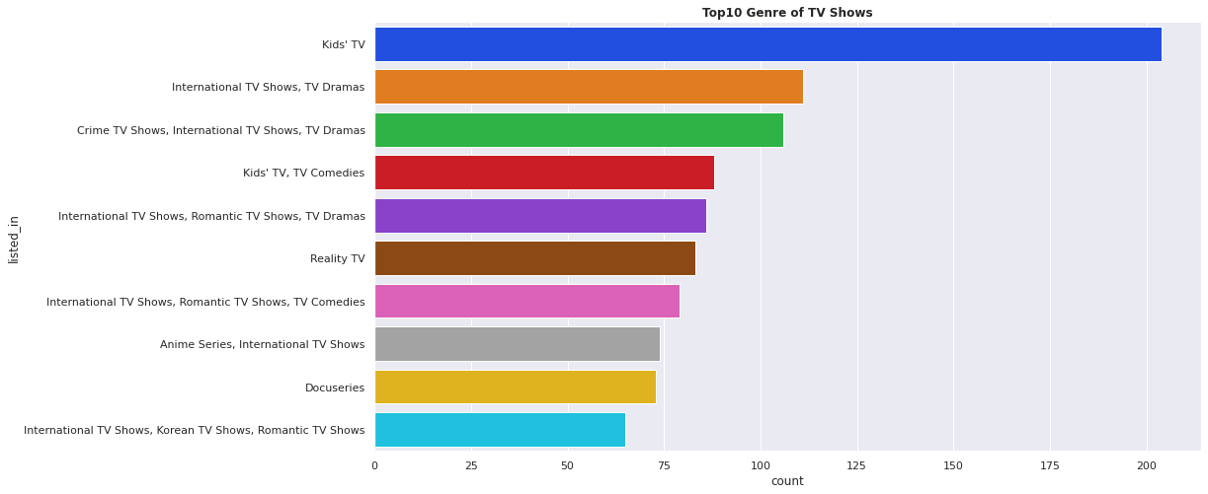
Genre
Top Genre of TV shows are as follows
Kid's TV
International TV shows, TV Drama
Crime TV shows, TV Drama

Slide 15
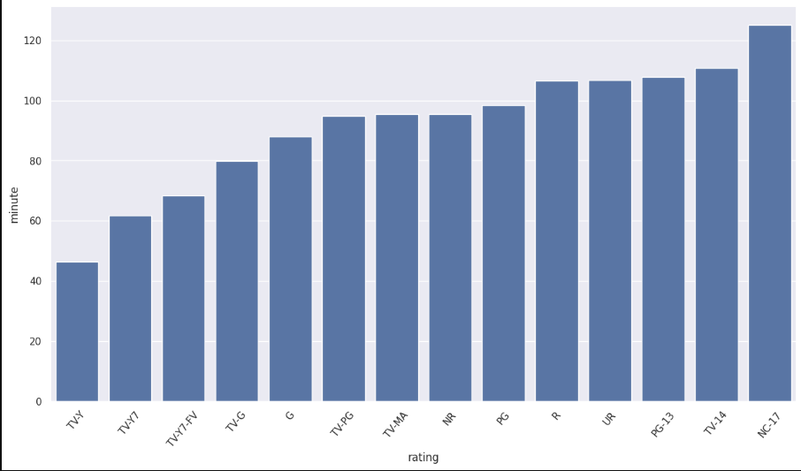
Duration
This bar plot clearly shows that the NC-17 rating type, along with TV-14 and PG-13, has the most runtime.

Slide 16
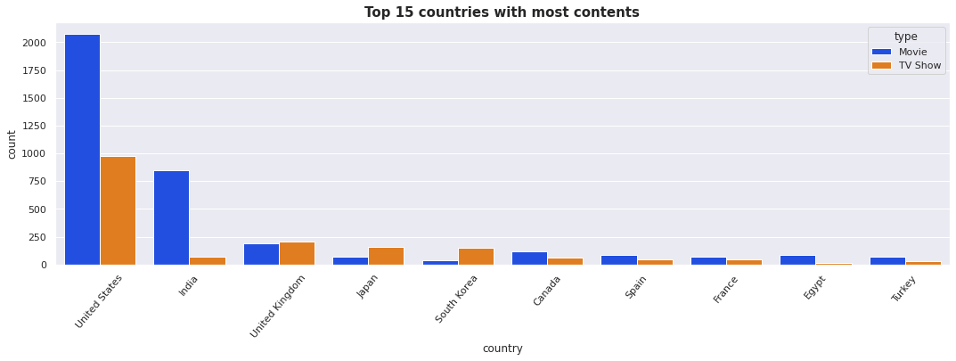
COUNTRY
This plot shows that the United States, along with India and the United Kingdom, has the most content.

Slide 17
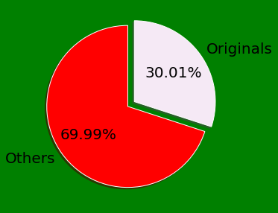
Originals
30% movies released on Netflix.
70% movies added on Netflix were released earlier by different mode.

Slide 18
Feature Engineering
1] Text data to strings
Import of stopwords from NLTK
Converting text data into lowercase text for uniformity
Remove Punctuations
Remove Stopwords
Now our text data is ready for vectorization.

Slide 19
Feature Engineering
2] Vectorization
Text Data
TFIDF Vectorization
Array format for clustering
Convert a collection of raw documents to a matrix of TF-IDF features.

Slide 20
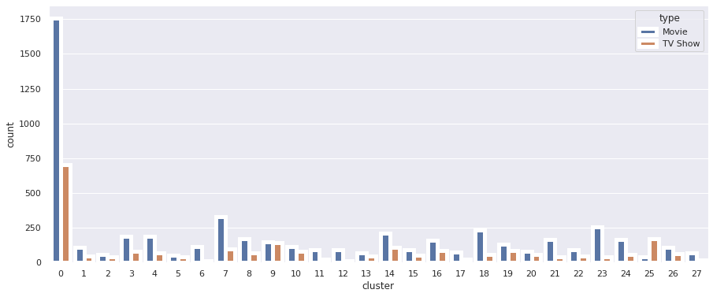
1. K-means Clustring
By value count we can see that maximum observations are stored in cluster 0 that is 2462. This will be the biggest cluster.

Slide 21
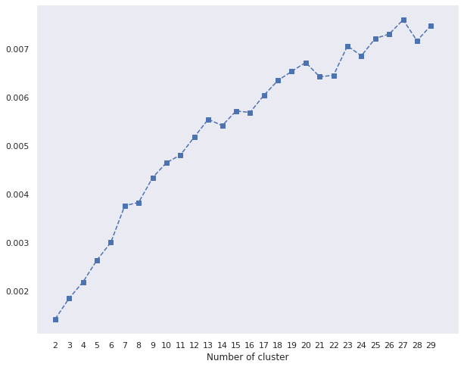
1. K-means Clustring
Finding the optimal number of clusters using the elbow method
Using the elbow method and the Silhouette score, 28 clusters were formed.

Slide 22
2. Agglomerative Clustring
Agglomerative Clustering is a bottom-up approach to clustering in which each data point is considered as a single-point cluster and then successively merged with other clusters based on a similarity metric. The process continues until all points are merged into one large cluster or a stopping criterion is met.
This approach can be used for hierarchical clustering, where the result is represented as a tree-like structure called a dendrogram.
Silhouette Coefficient: -0.002
Davies Bouldin Score: 13.979

Slide 23
Conclusion :
Based on the elbow and silhouette scores, the optimal of 28 clusters formed, K Means is better for identification than Hierarchical, as indicated by the evaluation metrics. kmean cluster 5 has the most data points and is evenly distributed for the other clusters.
Netflix has 5372 movies and 2398 TV shows; movies outnumber TV shows on the service.
TV-MA has the most ratings for television shows, i.e. adult ratings.
Netflix adds the most content from October to January.
Documentaries are the top most genre in netflix which is followed by stand up comedy and Drama and international movies.
Kids television is the most popular TV show genre on Netflix.
The majority of the films range in length from 50 to 150 minutes.

Slide 24
Conclusion :
The most films were released in 2017 and 2018, with the most films being released in 2020. The number of movies on Netflix is increasing at a much faster rate than the number of TV shows. Following 2015, there was a significant increase in the number of movies and television episodes. After 2020, there is a significant decrease in the number of movies and television episodes produced. Netflix appears to have prioritised increasing movie content over TV shows. Movies have grown much faster than television shows.
Movies with an NC-17 rating have the longest average duration.When it comes to movies with a TV-Y rating, they have the shortest average runtime.
The United States has the most content on Netflix, followed by India.
India has the most Netflix movies. * 30% of Netflix movies are released in India. 70% of the movies added to Netflix were previously released in a different mode.
The greatest number of television shows consisting of a single season

